Slide 1
Cambio2.0
Diagnostic functions
Diagnostic variables
Propagate
ClimateState
Parametric variables
ClimateParams
Prognostic variables
ClimateState
Collect Climate
TimeSeries
Time series (numpy arrays)

Slide 2
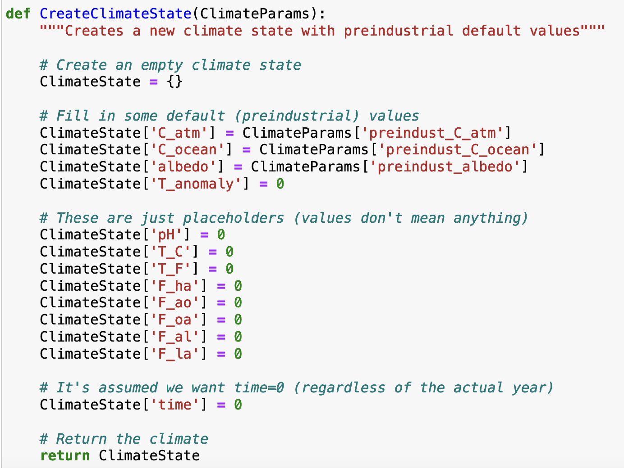
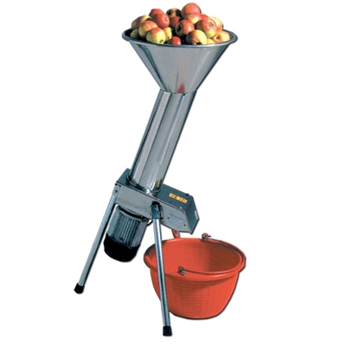
How functions work

Slide 3
How functions work

Slide 4
How functions work

Slide 5
How functions work

Slide 6
How functions work
$$κ_{T}$$

Slide 7
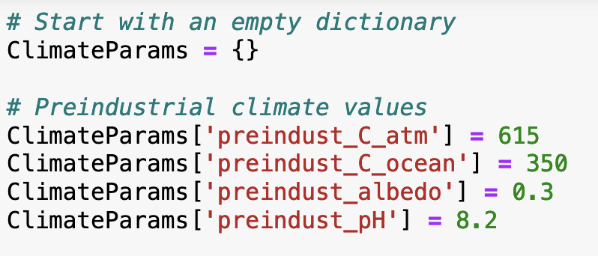
How dictionaries work
Creating a dictionary

Slide 8
How dictionaries work
Creating a dictionary
Adding values to a dictionary

Slide 9
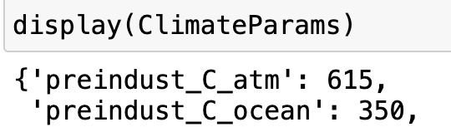
How dictionaries work
Creating a dictionary
Adding values to a dictionary
Displaying contents of dictionaries

Slide 10
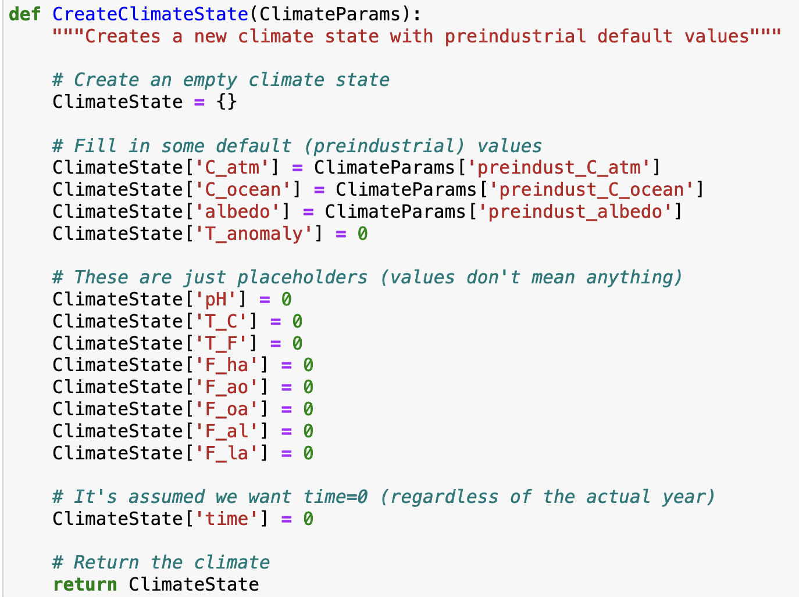
How dictionaries work
This is a function that creates a dictionary!

Slide 11
How dictionaries work
This is a function that creates a dictionary!

Slide 12
How dictionaries work
This is a function that creates a dictionary!

Slide 13
How dictionaries work
This is a function that creates a dictionary!
Here we’re creating at new dictionary (called ClimateState)

Slide 14
How dictionaries work
This is a function that creates a dictionary!
Here we’re extracting a value from the ClimateParams dictionary

Slide 15
How dictionaries work
This is a function that creates a dictionary!
Here we’re putting that value into the (new) ClimateState dictionary

Slide 16
How dictionaries work
Here we’re creating at new dictionary (called ClimateState)
This is a function that creates a dictionary!
Here we’re extracting a value from the ClimateParams dictionary
Here we’re putting that value into the (new) ClimateState dictionary

